Slide 1
Marketing Management

Slide 2
Meaning Of Marketing
Marketing is an organizational function and a set of processes for creating, communicating, and delivering value to customers and for managing customer relationships in ways that benefit the organization and its stakeholders.

Slide 3
Marketing Management
Marketing management is the art and science of choosing target markets and getting, keeping, and growing customers through creating, delivering, and communicatingsuperior customer value.

Slide 4
STP OF Marketing management
Segmentation : Breaking the big market into small segments basis certain parameters .i.e Gender, age, income etc
Targeting / Target Market : Identification of the segment that presents the greatest Opportunity.
Positioning : -Creating / Taking a place in customer’s mind

Slide 5
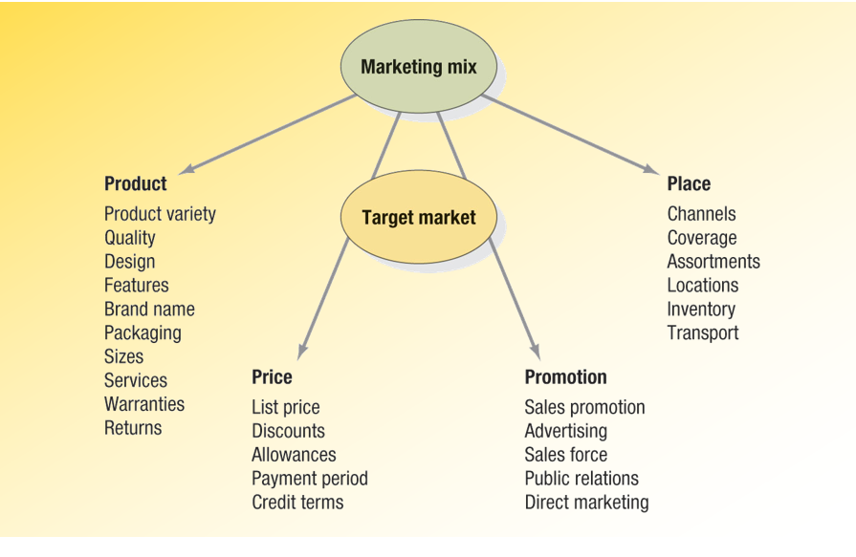
Marketing Mix (4 p’s)

Slide 6
Meaning of product
A product is anything that can be offered to a market to satisfy a want or need, including physical goods, services, experiences, events, persons, places, properties, organizations, information, and ideas.

Slide 7
Product Mix
Product-line pricing (Pricing Line Rather then single)- Shirts @ 500-1000-1500
Optional-feature pricing- Car’s Basic Model
Captive-product pricing- Printer & Cartridge
Two-part pricing : Fixed Fee plus Variable-Telecom
By-product pricing : Charge Less for main product if Byproduct is valuable to the customers
Product-bundling pricing
Pure Bundling:- Firm offers its products only as bundle
Eg Travel Packages: Travel cost, sightseeing, stay & food exp.
Mixed Bundling : Seller offers both Individually and in Bundles
Charges less for Bundles.

